Slide 1

PLAY NOW

Slide 2
Back to Game
Restart Game
Save Game
Exit Game

Slide 3
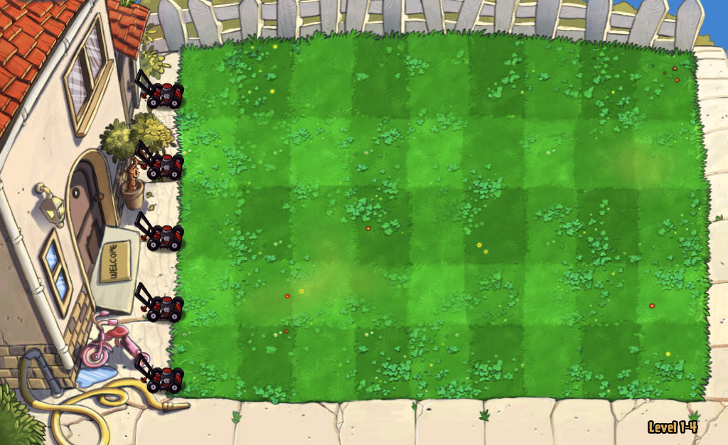
Made by – Himanshu and Udit

Slide 5
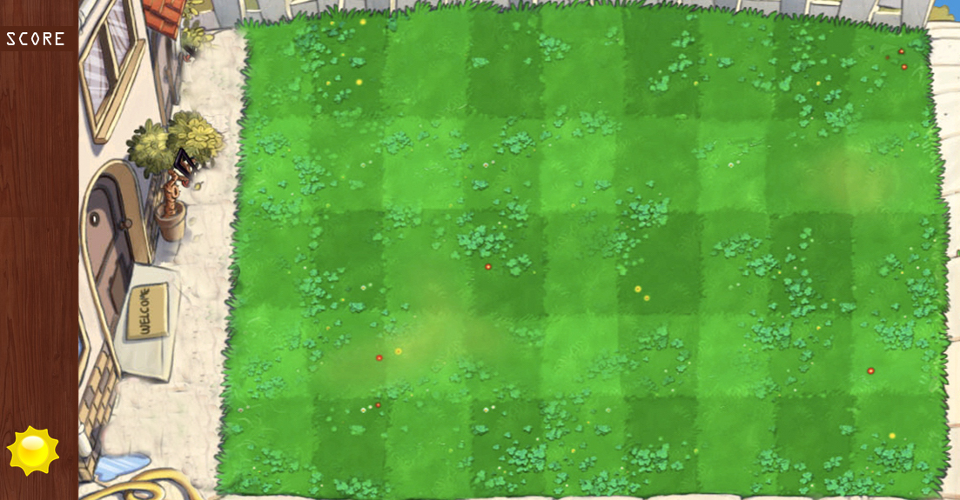

Slide 6
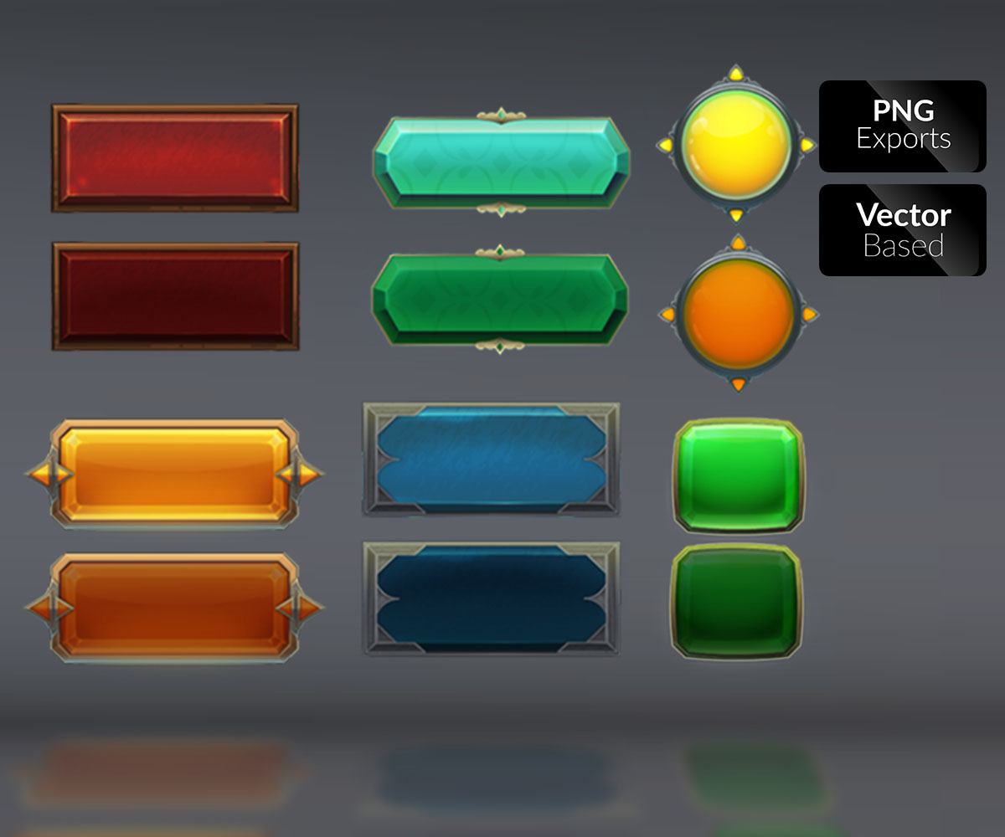
SAVE
RESTART
LOAD GAME
NEW GAME
EXIT

Slide 7
CHOOSE LEVEL

